Slide 1
Customer segmentation

Slide 2
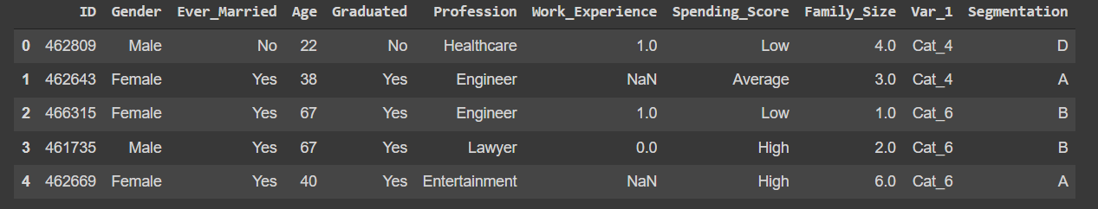
In this project we are trying to make a prediction on the right group of new customers for an automobile company.
The automobile company has plans to enter new markets with their existing products. After intensive market research, they’ve deduced that the behavior of new market is similar to their existing market.
“In their existing market, the sales team has classified all customers into 4 segments (A, B, C, D ). Then, they performed segmented outreach and communication for different segment of customers. This strategy has work exceptionally well for them. They plan to use the same strategy on new markets and have identified 2627 new potential customers.
Below, there’s a part of data set for you, to have better understanding of it.
This is a classification problem with target "Segmentation" column (A, B, C, D ).”
Source: Kaggle

Slide 3
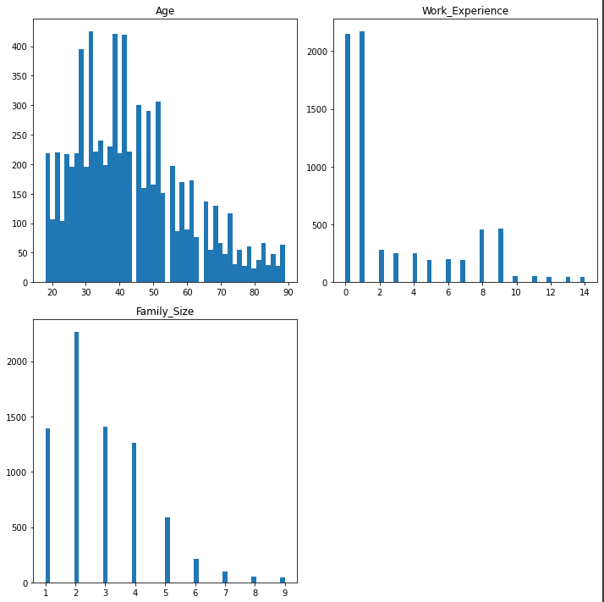
Firstly, we can take a look on numeric values of our data set. Per visualization on the right, we see that we have the most amount of customers at age around 30 and 40 years old and the number drops with the age: the least number of customers are at age close to 90.
As for work experience, next visualization shows that the most customers have from 0 to 1 year of work experience. And then there’s also significant number of ones with 8-9 years of experience.
Last visualization shows that most of customers have family of 2. There’s also significant amount of customers with family size of 1,3 and 4. Bigger families are not as common.

Slide 4
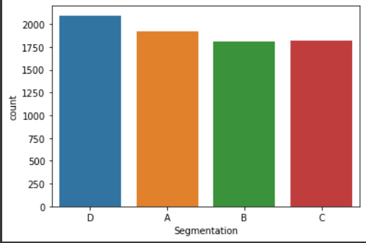
Next step, we are exploring our target - 'Segmentation'.
Visualization on the left shows that four segments of customers are pretty balanced, meaning the amount of customers of each segment is about the same with a little difference for segment ‘D’

Slide 5
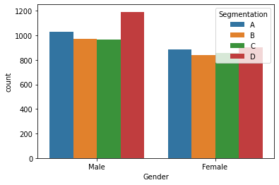
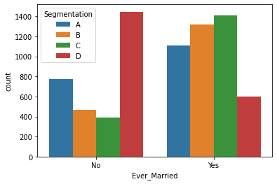
Now, we are exploring how different aspects correlate with Segmentation.
First visualization show that there's a bigger segment ‘D’ of Male and Female. Otherwise all segments are pretty balanced genderwise.
Next visualization shows that the biggest segment among non-married people is ‘D’ and for married is ‘C’.

Slide 6
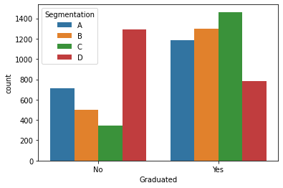
Visualization below shows that the most ungraduated people fall under ‘D’ segment and graduated are segment ‘C’, ‘B’, ‘A’ respectfully.

Slide 7
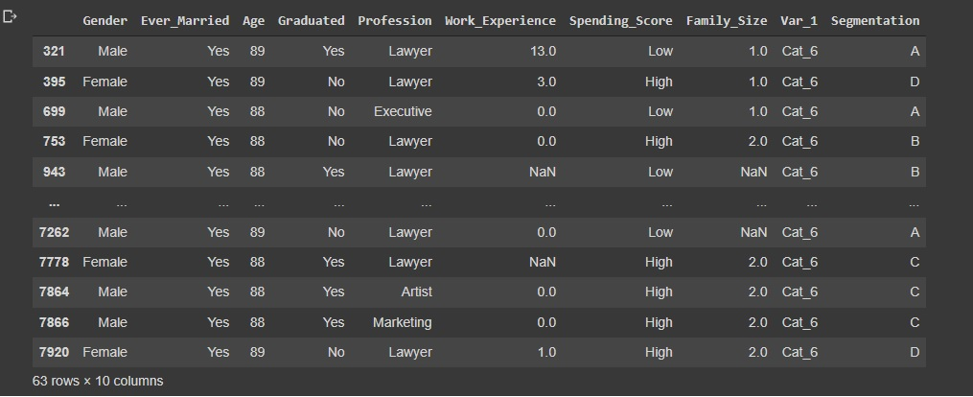
Anomaly

Slide 8
After analyzing our data by segments i would assume that:
- Seament "A" mostly includes male, married, artist, graduated, with 1 year or less work experience and belong in cat_6;
- Segment "B": male, married, artist, graduated, with 1 year or less work experience and belong in cat_6;
- Segment "C": male, married, artist, graduated, with 1 year or less work experience and belong in cat_6;
- Segment "D": male, not married, healthcare worker, not graduated, with 1 year or less work experience and belong in cat_6;

Slide 9
It was pretty hard to achieve high model accuracy on this dataset.
After performing data preprocessing and evaluating different machine learning models, we came to conclusion, that eXtreme Gradient Boosting model with some tuning gave the best results:
Training accuracy: 56%
Testing accuracy: 52%
We achieved the highest accuracy and the smallest overfitting with XGB model. Therefore, I would recommend using this model for test set.

Slide 10
Data analysis shows, that categories segmentation is kind of odd. As we can see, customers that fall under categories A, B and C have the same features. D category varies, though.
The company should try to collect more data and/or reconsider categorization. In that case that could be possible to achieve better accuracy for the models.
With data, that is available for us to use, after performing different preprocessing steps and evaluating couple models, we were able to achieve 56% accuracy on training data.
Based on how our model performs on testing data, we could conclude that 52% of new customers will end up in the proper category.
If this model will be used on a new data, it might need some development, since the accuracy of 56% wouldn’t show the complete picture of customers segmentation, but it still can give an idea of customers diversity.

